Slide 1
Bringing Prevention to Your Career and Your Community
Judith Zatkin, PhD
Judith.Zatkin@bemidjistate.edu

Slide 2
Today’s Agenda
Introductions
Context and Climate
Primary, Secondary, and Tertiary Prevention
Break!
Evidence: From Research to Practice
The Social Ecological Model
Self-Care as Prevention
Building your Prevention Toolbox

Slide 3
Introductions!
Assistant Professor of Psychology at Bemidji State University
PhD in Applied Psychology from Portland State University
ATSA Executive Board of Directors
Research focuses on organizational sexual violence prevention
Teaches the following gender and sexuality related courses:
  Human Sexuality
  Psychology of Women and Gender
  Sexual Violence Prevention

Slide 4
Introductions!
What is your name?
What is your work affiliation?
What are you looking to learn today?

Slide 5
My prevention STory

Slide 6
Telling Your Prevention Story
Why do you do this work?
When is the first time you thought about the importance of prevention?
Do you currently see yourself as a preventionist? Why or why not?
Is a world without sexual violence achievable?

Slide 7
Everyday Prevention
We often think of Prevention as big, sweeping, evidence-based interventions with the goal of eliminating all sexual violence.
This is a nice goal, but it can be disheartening.
We can do little things everyday to prevent sexual violence!

Slide 8
Big and Small: Setting Goals
Big(er) Prevention
Apply for a large grant to fund a campus-wide sexual violence education program
Implement a system-wide training program for staff and faculty that discusses Title IX, Healthy Boundaries, and responding to disclosures
Develop and teach a yearly course on sexual violence prevention
Everyday Prevention
Talk with my students about the importance of bodily autonomy, consent, and facing rejection when I teach
Teach about child sexual abuse by pushing back against common narratives, and centering treatment as prevention
Kindly push back when my students engage in victim blaming for sexual violence
Take some time to brainstorm at least 2 Big and 2 Everyday Prevention Goals for yourself!

Slide 9
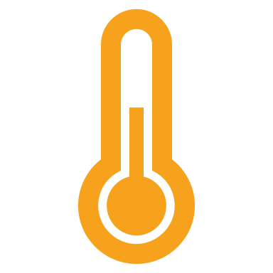
Climate and Context

Slide 10
The Importance of Context
Prevention is only as good as its match to its context and climate
What works in one context may not work in another
What works on campuses likely won’t work in other settings (hospitals, summer camps, treatment centers)
What works on one campus may work on another, but climate can torpedo the best planned interventions
We can learn from what works in other settings, but understanding climate is key to success

Slide 11
Conducting a Mini Climate Assessment
Break down your workplace or community into four (or more!) levels
01
Determine key stakeholders at each level
02
Brainstorm a series of questions to ask about each level
03
Risk factors or barriers to success
Protective factors
Use the analysis to understand the complexity of your specific context
04

Slide 12
Climate Consideration #1: My Department
Are there restrictions on how you teach your courses?
Does your department value diversity, equity, and inclusion?
Are you able to develop your own courses?
Are your colleagues collegial, or is there departmental drama?
Do you have tenure? Is your employment precarious? How does that impact your role in the department?

Slide 13
Climate Consideration #2: Administration and Resources
Is your administration vocal about campus sexual violence?
What budget exists for resources for students impacted by sexual violence?
Does your campus have a women’s center? A sexual violence prevention center? An LGBTQ+ center? A Multicultural center? A student conflict resolution center? Resources for students who perpetrate?
Does your campus have mandated or mandatory reporting policies, and are they well known?
Is there any campus-wide mandatory training for students surrounding sexual violence prevention?
  Is it effective?

Slide 14
Climate Consideration #3: The Students
What are typical religious and political affiliations for students at your institution?
What does diversity look like for your students?
Are most of your students of traditional college age?
  Are there high schoolers taking your courses?
Are there student organizations dedicated to sexual violence prevention, activism, or feminism?
  Are these organizations visible on campus?
How involved are parents?

Slide 15
Climate Consideration #4: The Greater Campus Community
What are the political and religious affiliations of the community at large?
Are there prominent community-based sexual violence prevention organizations? What kind of work do they do?
Do most of your students live on campus? Off campus?
Do students stay in town after graduation?
What does your alumni network look like?
What sexual violence stories, issues, or causes are prominent in your community?

Slide 16
My Climate Picture
Supportive department that emphasizes academic freedom and DEI in coursework.
Administration wants resources for survivors on campus, but does not prioritize them. Most sexual violence prevention work is coordinated by a community organization. Perpetration resources do not exist.
Students lean conservative and religious, and there is limited diversity on campus. Most have never been outside of Northern Minnesota.
Bemidji is the most liberal area in a very conservative region. A decent percentage of our faculty and staff are alum, or are from Northern Minnesota. A large community focus on trafficking.

Slide 17
Your Climate Assessment
Select one of your prevention goals we brainstormed earlier– big or small!
Break up your setting into four levels of analysis
Brainstorm relevant questions about your goal at each setting
Consider key stakeholders
Consider both risk and protective factors
Write or draw an overall picture of your climate

Slide 18

Share your Climate Picture with your table!

Slide 19
Primary, Secondary and Tertiary

Slide 20
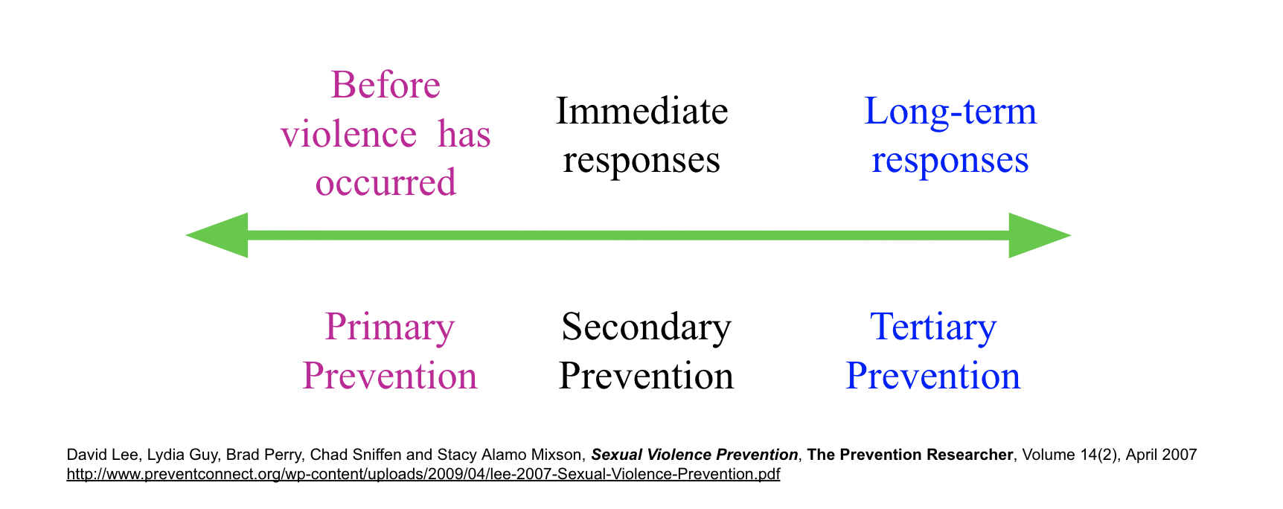

Slide 21
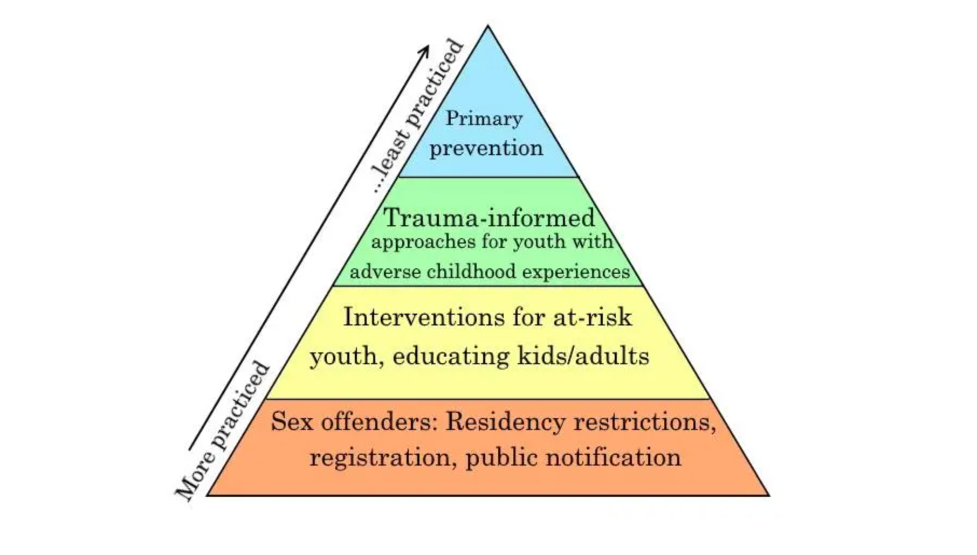

Slide 22
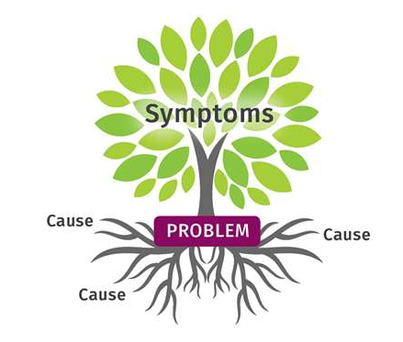
Why Primary Prevention?

Slide 23
Examples
Primary Prevention
  A healthy sexuality curriculum in public schools
Secondary Prevention
  Bystander intervention programs
Tertiary Prevention
  A treatment program for those who have sexually offended on campus

Slide 24
Placing Your Work
Which parts of your work would you categorize as Primary, Secondary, or Tertiary Prevention? Why?
What are some ways you might accommodate the levels that are missing in your current work?

Slide 25

Break!

Slide 26
Evidence based practice

Slide 27
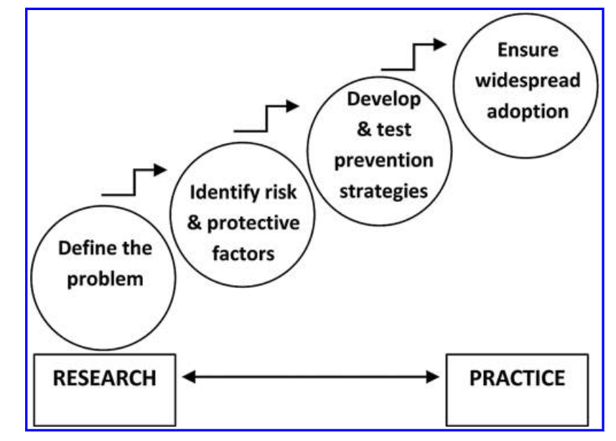
DeGue et al, 2012

Slide 28
The importance of Evidence
For Big Prevention, it is important that we know that our interventions will not cause harm
  We also want them to work
Prevention is never perfect. We have not yet seen an intervention that eradicates sexual violence from any context
When we make decisions about what to fund, we want to see that the intervention makes a difference.

Slide 29
Promising Programs
What’s OK?
  A website built by Stop It Now! where young people can chat with counselors about any questions they have about sexuality
  www.Whatsok.org
Help Wanted
  An online course to help individuals who are attracted to younger children, with the goal of helping them live a safe and non-offending life
  https://www.helpwantedprevention.org/
Talking for Change
  Canada-based free therapy and anonymous support for people are attracted to minors, and those who know someone with a sexual interest in children.
  https://talkingforchange.ca/
STARRSA
  A campus-based program that uses cognitive behavioral therapy (CBT) and active psychoeducation (AP) to prevent the perpetration of campus sexual violence

Slide 30
Evaluating small prevention
The Public Health Model is meant to evaluate best practices for Big Prevention, but I sometimes like to use it to test the effectiveness of my Everyday Prevention
While smaller daily tactics cannot take the place of evidence based programming, it is still important to evaluate your actions regularly

Slide 31
A Practice
Select an Everyday Prevention Problem you would like to solve
  When I do this activity with my students, I have them prevent late work
Brainstorm 3-5 reasons why your problem might be occurring. Select one reason to use for the rest of the practice
Using your brainstormed root cause, come up with two risk factors and two protective factors.
Consider two strategies based on your root cause that might work to prevent your problem. Consider how you might test these strategies
Discuss how you would implement your final prevention strategy in your context

Slide 32

The Social Ecological Model

Slide 33
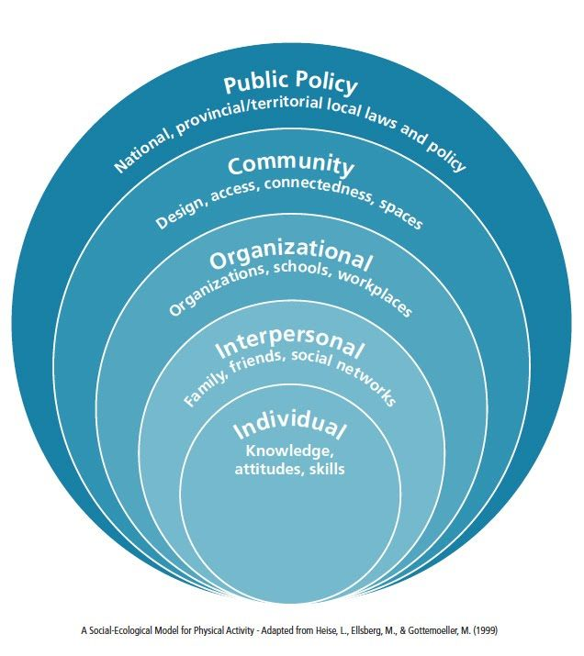

Slide 34
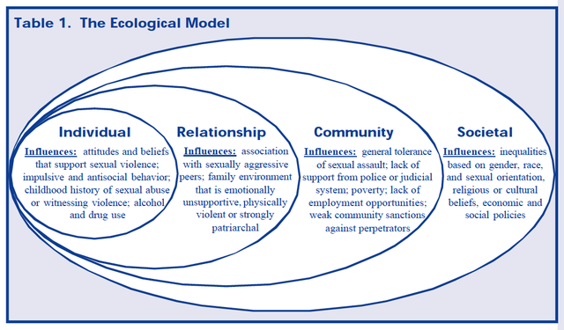
PreventConnect, 2017

Slide 35
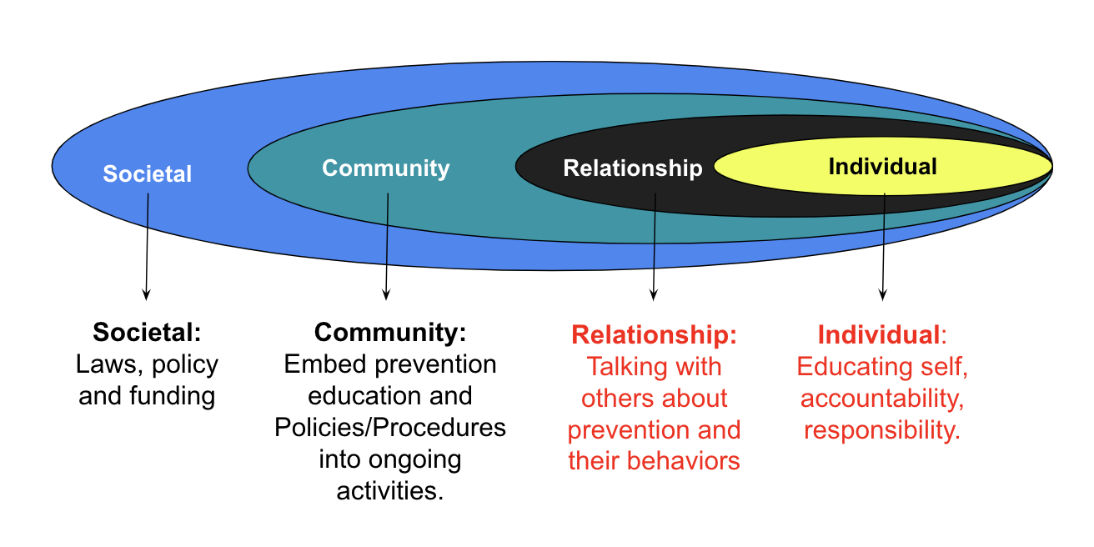
Coleman, 2023

Slide 36
Leveling up
Much of the prevention work we see is conducted at the individual or relationship level
  Education and therapy are very common here
Many prevention researchers argue that they key to long-term change is to impact community and societal levels (McMahon, 2015)
Leveling up is hard, but helps us impact those root causes of sexual violence more effectively
  The ecological fallacy is when we mislabel or create an intervention for the wrong level
  Consider how residency restrictions and community notification might impact treatment for those who have sexually offended

Slide 37

Level up your work
At which levels of the socioecological model does your work currently exist? Why?
How might you level up your own work to impact change at the community and/or societal levels?

Slide 38
A quick note on Self-Care
Preventing burnout is prevention! We cannot do our work effectively if we do not take care of ourselves
What are some of your best strategies to ensure you are able to do your best work?
How does communicating with others in our field help you do your best work?

Slide 39

Building your toolbox

Slide 40
Wrap-Up Questions
What are three strategies that you might consider incorporating into your work?
1
What questions do you still have about prevention?
2
Do you see your work as more prevention oriented than when you started this workshop?
3

Slide 41
Thank you!
Judith.Zatkin@bemidjistate.edu

