Slide 1
Evidence Informed Approaches with Compulsive Sexual Behavior Disorder: A Strength Based Approach
Drew A. Kingston, Ph.D., ATSAF
dkingston@hopeprogram.biz
Notes:
Welcome
Introduce self
I also am happy to share some of the articles I show today – some of which are only highlighted in passing.

Slide 2
Learning Objectives
Defining features of CSBD and its place in current nosology.
Recent normative data and associated assessment practices. Relevant cultural considerations will also be discussed.
Strategies to address CSBD, including among those who have committed sexual offenses.

Slide 3
Agenda
Definition
Conceptualization
Relevance to our work (people who commit sexual offenses)
Structure of the construct
Assessment
Relevant Normative Data
Recommended Approaches
Treatment
Current Approaches
Recommended Approaches
7. Any other goals for today?

Slide 4
What is it?

Slide 5
What is it?

Slide 6
On Click Animated Version
Sexual Addiction
Sexual Compulsivity
Hypersexuality
Paraphilia-Related Disorder
Sexual Impulsivity
Compulsive Sexual Behavior Disorder
Sexual Sensation Seeking
Hyperlibido
Problematic Hypersexuality
Notes:
When I ask the question - What is it, a related one is what do we call it
A number of terms have been used
Considerable disagreement
Is it semantics or does it matter
What do you think?
What term do you use?

Slide 7
Controversy
Value laden concept
Disorder vs symptom
Pathologizing healthy sexual behavior
Lack of research
Clinical implications
(Giles, 2006; Ley, 2012; Levine & Troiden, 1988)
Notes:
Its controversial
Value laden - a cultural invention and artificially constructed to reflect deviations from normative standards
correlation made between prevailing sexual scripts (+ or - )and emphasis placed on inhibited vs disinhibited sex
Disorder or a by-product of something else that is more germane
It is simply high sexual drive.
Lack of research, although this is changing
Clinical implications. Similar to concerns about (PCD)

Slide 8
A “Simple” definition
Hypersexuality = a stronger than usual urge to have sexual activity
Notes:
APA defines hypersexuality as a stronger than usual urge to have sexual activity
I don’t think anyone would argue that hypersexuality is a thing – meaning that some people think about sex a lot or have a lot of sex based on some reference point
But, this simplistic definition leaves much to be desired.

Slide 9
A “Simple” definition
Hypersexuality = a stronger than usual urge to have sexual activity
Notes:
What is stronger – stronger than what. I want to circle back to this definition when we discuss norms
What is usual – Is it usual for them now or ever. Does it take current circumstances into account. Someone who is in the early 20's or maybe in a new relationship may have a lot more sex than someone who is in the late 60's and has been with their partner for 40 years

Slide 10
Essential Elements
Symptoms
Objective and Observable
Frequency of Sexual Activity
Total Sexual Outlet
Subjective/Experiential
Volitional Impairment
Impairment
Significant distress or disability in social, occupational, or other important activities
APA, 2022; Kinsey et al., 1948
Notes:
So, here we have two essential elements to CSBD that I will be discussing:
A set of symptoms
Objective indicators (essentially indicators of high sex drive such as freq of sex and TSO)
TSO is the # of orgasms experienced over 7 days - 7+
Subjective indicators ( lack of perceived control, feelings of shame and guilt, obsessive thoughts, etc)
2) Impairment
Which is an essential element of determining something to be a disorder per APA.

Slide 11
Manifestations
Solo vs relational sexual activities
Paraphilic vs non-paraphilic
Notes:
It is also important to look at the different ways in which hypersexuality can manifest
You can have sexual behavior that is "impersonal" or solo which typically involves masturbation and porn consumption
or sexual behavior that is engaged with someone else
Also, sexual behavior can be paraphilic: essentially directed toward non-human objects or non-consenting people.
You can also have a focus on sexual behavior on non-paraphilic or culturally normative

Slide 12
Manifestations
Solo vs relational sexual activities
Paraphilic vs non-paraphilic
Notes:
With CSBD as we know it, we are talking about behavior that is
Solo and/or relational and culturally normative

Slide 13
Manifestations Carnes (1989)
1. Masturbation, sexual relationships, pornography, prostitution
2. Exhibitionism, voyeurism, indecent phone calls
3. Child molestation, incest, and rape
Notes:
Let’s take one more look at manifestations or what we see when a client enters the office and talks about his or her concerns regarding CSBD

Slide 14
Manifestations Kafka (2010)
Masturbation
Pornography
Sexual Behavior with Consenting Adults
Cybersex
Telephone Sex
Strip Clubs
Notes:
Let’s take one more look at manifestations or what we see when a client enters the office and talks about his or her concerns regarding CSBD
This list is from Kafka and the proposal for DSM-5.
Read them
Although some types today might be a bit less prevalent than they were in 2010, This is an improvement, in my opinion, from earlier descriptions of sexual addiction that included these types but also sexual assault agains adults and children as the highest level of addition simply because there was a boundary violation

Slide 15
Treatment-Oriented Typology
Paraphilic Hypersexuality
Avoidant Masturbation
Chronic Adultery
Sexual Guilt
The Designated Patient
Another Condition
Cantor et al. (2013)
Notes:
PH – high sexual drive and behaviors and sub-clinical paraphilic interests which can often get overlooked
AM – next largest referral – uses sex to avoid tasks and responsibilities. No paraphilias evident
CA – frequent cheating but not a ton of time spent in other sexual behavior
SG – Substantial guilt resulting from sexual behavior often low levels of sex. Typically have highly religious or moralistic standards
DP – the type I saw most - partner saying you need help
AC -
What types do you see – does it matter?

Slide 16
Conceptualization
Notes:
Conceptualization seemed to dominate the research literature for quite some time and this speaks to the lens with which we view the construct
I will review several of the major ones here

Slide 17
Initial Big Three
Sexual Impulsivity
Sexual Addiction
Sexual Compulsivity
Notes:
These three models are considered variants of the core model
That is, OCD, ICD and addiction or substance dependence
They adapted criteria from each to “fit” the sexuality

Slide 18
Sexual Compulsivity (Coleman, 1987)
OCD characterized by:
Obsessions – recurrent/persistent thoughts urges that are experienced as intrusive and unwanted
Compulsions – repetitive behavior or acts that an individual feels driven to perform in response to #1
Sexual Behavior is intended to reduce the anxiety and distress
Focus on negative reinforcement and removing negative emotional states

Slide 19
Sexual Impulsivity (Barth & Kinder, 1987)
Impulsivity
Predisposition toward rapid, unplanned reactions to stimuli with diminished regard for negative consequences
Essential Features of ICD
Failure to resist an impulse, drive or temptation that is harmful to self/others
Increase sense of tension before
Pleasure, gratification or release during
Possible guilt after
Emphasis on increasing positive emotional states
Notes:
ICD focus on problems with self-control of emotions and behavior
Moreover, the behaviors violate the rights of others or bring them into conflict.
The critical feature here is the desire to increase positive emotional states as opposed to alleviating negative emotional states
With sexual bheavior, proponents argue that people repeatedly engage in sexual activity despite knowledge that it is harmful.

Slide 20
Sexual Addiction (Carnes, 1983, 2001)
Addiction = maladaptive pattern of substance use with impaired control and adverse consequences
DSM-5 includes cluster of symptoms related to continued use
Impaired Control
Social Impairment
Tolerance
Withdrawal
Impulsivity transitions toward Compulsivity
Behavioral Addictions
Sexual Addiction = pathological relationships with a mood altering experience
Notes:
Sexual Addiciton is probabaly the most discussed conceptualization, particularly in the general public.
Let’s take a step back and talk about addiction as a construct.
It is a cluster of symptoms (cog, behave, and physiological) that surround the fact that the individual consumes this substance despite consequences.
Several criteria surrounding
Impaired control, social impairment, risky use and pharmacological criteria
Let’s list them specifically next

Slide 21
Sexual Addiction (Carnes, 1983, 2001)
A. Minimum of 3 criteria over 12 months
Recurrent failure to resist impulses to engage in sex
Frequent engaging in sex to a greater extent or longer duration than intended
Unsuccessful efforts to stop or reduce sex
Inordinate amount of time spent on sexual behavior
Preoccupation with sexual behavior
Frequent sexual activity despite obligations
Continuation of sexual behavior despite problems
Need for increased sexual behavior for desired effect
Giving up other activities because of sex
Negative emotions if unable to engage in sex
B. Problems or Social Consequences
Notes:
Sexual Addiciton is probabaly the most discussed conceptualization, particularly in the general public.
Let’s take a step back and talk about addiction as a construct.
It is a cluster of symptoms (cog, behave, and physiological) that surround the fact that the individual consumes this substance despite consequences.
Several criteria surrounding
Impaired control, social impairment, risky use and pharmacological criteria
Let’s list them specifically next

Slide 22
Review of the Big Three
Inadequate application of models to sexual behavior
OCD – behaviors are typically not behavioral representations of the cognition
Impulsivity - evidence of planning (e.g., cruising) – generalized versus context specific impulsivity?
Addiction – progression is untested and concerns about term “addiction”
Impulsivity versus compulsivity
Contrasting (albeit limited) evidence from clinical samples
Motivation may vary within and across individuals
Kingston & Firestone, 2008
Notes:
Much of the review and debate about conceptualizations focused on sexual addiction, compulsivity and impulsivity.
Addiction is vague and perjorative to some
Ultimately there is heterogeneity and not everyone fits into a compulsive or impulsive like model. In fact, data shows variability across and within samples specifically in regards to motivational mechanisms.
Addiction says this but there path from imp to comp is not clear in hypersexuals
Field seems to be moving toward impulsivity which may actually be the right move based on the fact that impulsivity seems to be complex
UPPS measure taps into posivite urgency (act under positive circum), negative urgency, lack of premeditation, lack of perseverance, and sesnsation seeking. Much more complex than simply increase the positive emotional states originally conceputalized

Slide 23
Dual-control Model (Janssen & Bancroft, 2023) Janssen, (2023, September 30) Youtube. https://www.youtube.com/watch?v=0JeHr9VNQbs
Notes:
The dual control model was developed by Kinsey Institute researchers – namely John Bancroft and Erick Janssen and it has been subjected to a number of studies.
The idea of the dual control model is that sexual response in humans varies based on an interaction or role of sexual excitation and sexual inhibition
We would say that the dual control model is an example of a conceptual nervous system very similar to other models such as the earlier behavioral activation and behavioral inhibition model.
researchers liken it to having both a gas pedal (excitation) and a brake pedal (inhibition) in a car - every person will engage one or both pedals to a differing degree in any particular sexual situation, depending on their unique sexual physiology, history, and personality

Slide 24
The Sexual Inhibition/Sexual Excitation Scales
45 items
One Sexual Excitation factor (SES)
“When I think of a very attractive person, I easily become aroused”
Two inhibition-related factors:
Threat of performance failure (SIS1)
“If I feel that I’m expected to respond sexually, I have difficulty getting aroused”
Threat of performance consequences (SIS2)
“If I realize there is a risk of catching a sexually transmitted disease, I am unlikely to stay sexually aroused”
(Janssen, Vorst, Finn & Bancroft, 2002)
Notes:
A fundamental aspect of research surrounding the dual control model is the SIS and SES scales
45 item “if then questions” on a 4 point scale
The SES factor - read example
SIS has two factors
- threat of performance failure
- threat of performance consequences
Number of studies have been conducted with these scales
Women tend to score higher on sexual inhibition and lower on sexual excitation compared with men
Also a short form available with 12 items

Slide 25
Relevance

Slide 26
Prevalence
Prevalence remains elusive (3%-6%)
Non-clinical samples - 1% - 10% (Böthe et al., 2019; Dickenson et al., 2019)
Highly prevalent among specific populations
HIV infected men – 30% (Parsons et al., 2012)
Military veterans – 14% (Kraus et al., 2017)
Individual convicted of a sexual offense – 30%-50% (Knight, 2011; Marshall & Marshall, 2006)
Notes:
prevalence remains elusive. Articles have often reported 3-6% without real attention paid to the methodology
There has, more recently, been more studies about this
The range is due to how we define, conceptualize and assess as well as other methodological issues such as selected samples.

Slide 27
CSBD and Sexual Offending
Developmental antecedent for sexual aggression (Knight & Sims-Knight, 2011; Malamuth, 2003)
Criminogenic need (Hanson & Morton-Bourgon, 2004; Kingston & Bradford, 2013; Kingston et al., 2007)
Risk relevant treatment target
STABLE 2007 (Hanson & Harris, 2004)
VRS-SO (Olver et al., 2014)
Notes:
Onset vs Persistent
not always one and the same - early abuse for example seems to play a role in onset but not persistence.
CSBD is directly relevant for sexual offending
Hypersex has relevance in etiological models (Confluence model and the work of Ray Knight and colleagues)
Also it has shown to be associated with recidivism - it is a criminogenic need and embedded in risk assessment tools.

Slide 28
Risk Relevant Concept: STABLE 2007
Sex Drive/Preoccupation
Frequency of sexual thoughts and behaviors and the degree to which they interfere with interpersonal and/or prosocial functioning
Scoring
0 – No evidence; frequency of sexual thoughts/behavior is reasonable for age and circumstances
1 – Some evidence of elevated sex drive or impersonal sex
2 – Clear evidence of preoccupation with sex or multiple preoccupations. Significant impersonal sexual activity
Notes:
On the stable, there are two risk relevant items that map onto CSBD.
This here is sex drive and preoccupation.
The manual provides some normative references that are actually a bit out of date now but we will come back to that.

Slide 29
Risk Relevant Concept: STABLE 2007
Sex as coping
Using sexual activity to manage emotional states
Scoring
0 – No evidence of using sex to cope. Stress is often associated with decreased sexual activity.
1 – Some evidence of sex as coping but other strategies are identified and used
2 – Clear evidence of sex as coping. Other strategies may be identified but they are rarely used
Notes:
Second item is sex as coping and is defined as….
So, you can see, the stable focuses on sex drive and sex as coping. This is interesting as it maps well onto the structure which I will present later on.

Slide 30
Risk Relevant Concept: VRS:SO
Sexual Compulsivity
Pattern of highly repetitive compulsive sexual behavior
Scoring
0 – no evidence of compulsive sexual activity
3 – repetitive deviant or non-deviant compulsive sexual activity. Excessive masturbation, use of prostitutes, promiscuity, difficulty controlling a powerful sexual drive
Notes:
Who here is familiar with the VRS:SO?
Describe it
It has an item reflecting sexual compulsivity that is defined as….
0-3 scale
3 incorporates deviant and non-deviant and focuses on sexual drive as well as compulsive elements (difficulty controlling). Also, casual, impersonal sex such as the use of prostitutes.

Slide 31
Motivation-Facilitation Model
Trait Factors (e.g., antisocial personality)
Facilitation + or -
Paraphilia
High Sex Drive
Intense Mating Effort
Situational Factors
Motivation
Sexual Offenses
Facilitation + or -
State Factors (e.g., alcohol use)
(Seto, 2019)
Notes:
Explain the model
Intense mating effort - the resources and energy placed on existing partner versus new and novel partners
All three motivators are relevant to today

Slide 32
Structure
Taxometrics and Dimensions

Slide 33
CATEGORICAL ENTITIES VS CONTINUOUSLY DISTRIBUTED TRAITS
Notes:
The first issue is whether something is taxonic (diff in kind) versus continuous (diff in degree).
Many taxons in biology but height is continuous
Why do we care
It changes our language and conceputalization – someone is a psychopathy or exhibits high levels of psychopathic traits – based on normative data.
Etiology – likely causal effects are multiply determined vs more specific
Assessment – cut-off points tied to our question (is this screening, treatment, or civil commitment
Taxometric analyses applies to a set of interrelated but non-redundant procedures invented by Meehl and colleagues and is the set of procedures that can be used to test whether something is cat or continuous.

Slide 34
Dimensions vs Categories (Haslam et al., 2020)
Notes:
Again, we talk about most disorder as thought they are categorical but is this accurate
In fact a meta analysis by Haslam and colleagues in 2020 examined 183 articles reporting 317 findings
Findings supported dimensional models which outnumbered taxonic models five to one

Slide 35
Is it Dimensional or categorical?
Frequently discussed as a taxon:
Conceptualizations (e.g., sex addiction)
Proposed DSM-5 Criteria (4/5; Kafka, 2010)
Total Sexual Outlet (7+ orgasms per week)
Assessment measures (SCS ≥ 24; HBI ≥ 53)
Notes:
our perception is one of dimensions but we discuss things as though they are taxonic
Primary metric -- comparison curve fit index (CCFI)
≤ .45 dimensional
.46 - .55 ambiguous
≥ .55 taxonic.

Slide 36
Taxometric Research (Graham et al., 2015; Marcus et al., 2011; Walters et al., 2011)
CCFI
0
Dimensional
0.45
Ambiguous
0.55
Taxonic
1.0
♂
♀
♀
♂
SOs
♂
♂
♀
♀

Slide 37
Kingston, D. A., Walters, G. D., Olver, M. E., Levaque, E., Sawatsky, M., & Lalumière, M. L. (2018). Understanding the latent structure of hypersexuality: A taxometric investigation. Archives of Sexual Behavior.
Notes:
Canadian sample of university and community participants where we employed the taxometric procedures and CCFI for HBI and SCS

Slide 38
Taxometric Research (Kingston et al. 2018 )
CCFI
0
Dimensional
0.45
Ambiguous
0.55
Taxonic
1.0
♂
♀
Total
♀
♂
♀
SOs
♂
♂
♂
♀
♀
Notes:
total sample and women showed dimensional
Men showed borderline categorical but we followed this up with additional analyses comparing the taxonic group with the upper complement of the comparison group and no difference were evident on sexula bheaviors.
Again, suggesting that the construct is dimensional

Slide 39
Dimensions of CSBD (Winters et al., 2010 Carvalho et al., 2015)
CSBD
Sexual Drive
Sexual frequency, preoccupation, impersonal sex
Notes:
Historically, CSBD has been seen as one predominant factor
Essentially that it is a high sex drive that results in problems due to attempts to control the sexual drive within the current cultural context
However, there was insufficient sampling of problematic sexuality items to generate a separate factor

Slide 40
Dimensions of CSBD (Kingston et al., 2017; Knight, 2018)
CSBD
Sexual Drive
Sexual freq, preoccupation, impersonal sex
Problematic Sexuality
Impulsivity and emotion dysregulation
Notes:
Ray Knight, myself and few others have looked at a larger number of items comprising this construct and have presented the construct as best represented along two factors:
Sex Drive and PS

Slide 41
Dimensions of CSBD (Kingston et al., 2017; Knight, 2018)
CSBD
Sexual Drive
Sexual freq, preoccupation, impersonal sex
Problematic Sexuality
Impulsivity and emotion dysregulation
Neuroticism
Anxiety
Depression
Behavioral dysregulation/negative emotionality
Sexual assertiveness
Sexual esteem
Sexual motivation
CM/ScI Psychopathy
Notes:
Ray Knight, myself and few others have looked at a larger number of items comprising this construct and have presented the construct as best represented along two factors:
Sex Drive and PS

Slide 42
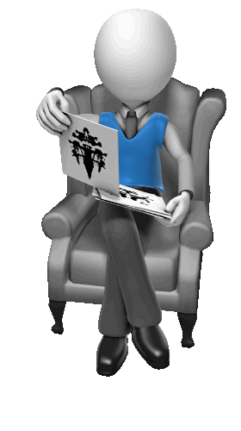
Definition and Assessment
Notes:
Let’s take the definition that I discussed and add a bit more description in relation to assessment and essential features
I want to first compare the criteria contained in the two diagnostic texts.
I recognize that the criteria proposed for the DSM-5 was rejected whereas the ICD-11 is accepted
I think comparing the two and considering the similarities and differences is a useful exercise.
Just keep in mine that only the ICD criteria shown is currently accepted.

Slide 43
Definition: Diagnosis (Gola, Lewczuk, Potenza, Kingston, Grubbs, Stark, & Reid, 2020)
Compulsive Sexual Behavior Disorder ICD-11 | Hypersexual Disorder DSM-5
Repetitive sexual activities become a central focus of the person’s life to the point of neglecting health and personal care or other interests, activities and responsibilities | Time consumed by sexual fantasies, urges or behaviors repetitively interferes with other important (non-sexual) goals, activities and obligations
Notes:
read

Slide 44
Definition: Diagnosis (Gola, Lewczuk, Potenza, Kingston, Grubbs, Stark, & Reid, 2020)
Compulsive Sexual Behavior Disorder ICD-11 | Hypersexual Disorder DSM-5
Repetitive sexual activities become a central focus of the person’s life to the point of neglecting health and personal care or other interests, activities and responsibilities | Time consumed by sexual fantasies, urges or behaviors repetitively interferes with other important (non-sexual) goals, activities and obligations
Excessive Focus and amount of time spent on sex while neglecting other areas
Notes:
Highlights an excessive amount of time and focus on sexual behaviors while neglecting other important goals and activities

Slide 45
Definition: Diagnosis
ICD-11 | DSM-5
A person makes numerous unsuccessful efforts to significantly reduce repetitive sexual behavior | Repetitive but unsuccessful efforts to control or significantly reduce these sexual fantasies, urges or behaviors.
Notes:
Impaired Control

Slide 46
Definition: Diagnosis
ICD-11 | DSM-5
A person makes numerous unsuccessful efforts to significantly reduce repetitive sexual behavior | Repetitive but unsuccessful efforts to control or significantly reduce these sexual fantasies, urges or behaviors.
Impaired Control
Notes:
Impaired Control

Slide 47
Definition: Diagnosis
ICD-11 | DSM-5
The pattern of failure to control intense, sexual impulses or urges and resulting repetitive sexual behavior causes marked distress or significant impairment in personal, family, social, educational, occupational, or other important areas of functioning. | Clinically significant personal distress or impairment in social, occupational or other important areas of functioning associated with the frequency and intensity of these sexual fantasies, urges or behaviors.
Notes:
Significant Distress and Impairment in Functioining

Slide 48
Definition: Diagnosis
ICD-11 | DSM-5
The pattern of failure to control intense, sexual impulses or urges and resulting repetitive sexual behavior causes marked distress or significant impairment in personal, family, social, educational, occupational, or other important areas of functioning. | Clinically significant personal distress or impairment in social, occupational or other important areas of functioning associated with the frequency and intensity of these sexual fantasies, urges or behaviors.
Significant Distress and Impairment in Functioning
Notes:
Significant Distress and Impairment in Functioining

Slide 49
Definition: Diagnosis
ICD-11 | DSM-5
A person continues the engagement in repetitive sexual behaviour despite adverse consequences. | Repetitively engaging in sexual behaviors while disregarding the risk for physical or emotional harm to self or others.
Notes:
Continued engagement despite adverse consequences

Slide 50
Definition: Diagnosis
ICD-11 | DSM-5
A person continues the engagement in repetitive sexual behaviour despite adverse consequences. | Repetitively engaging in sexual behaviors while disregarding the risk for physical or emotional harm to self or others.
Continued Engagement Despite Adverse Consequences
Notes:
Continued engagement despite adverse consequences

Slide 51
Definition: Diagnosis
ICD-11 | DSM-5
A person continues the engagement in repetitive sexual behavior despite deriving little or no satisfaction from it | Not Present
Notes:
Compulsive Engagement with less sexual satisfaction

Slide 52
Definition: Diagnosis
ICD-11 | DSM-5
A person continues the engagement in repetitive sexual behavior despite deriving little or no satisfaction from it | Not Present
Compulsive Engagement with Less Sexual Satisfaction
Notes:
Compulsive Engagement with less sexual satisfaction

Slide 53
Diagnosis
ICD-11 | DSM-5
Not Present | Repetitively engaging in sexual fantasies, urges or behaviors in response to dysphoric mood states or stressful life events
Notes:
Maladaptive emotional regulation
Big surprise that this is missing!!

Slide 54
Diagnosis
ICD-11 | DSM-5
Not Present | Repetitively engaging in sexual fantasies, urges or behaviors in response to dysphoric mood states or stressful life events
Maladaptive Coping/Emotional Dysregulation
Notes:
Maladaptive emotional regulation
Big surprise that this is missing!!

Slide 55
Definition: Diagnosis
ICD-11 | DSM-5
Distress that is entirely related to moral judgments and disapproval about sexual impulses is excluded | Not Present
Not better accounted for by another mental disorder, substance use, or medication | These sexual fantasies, urges or behaviors are not due to the direct physiological effect of an exogenous substance (e.g., a drug of abuse or a medication)
Paraphilic disorders are excluded
Notes:
Various exclusion criteria

Slide 56
Definition: Diagnosis
ICD-11 | DSM-5
Distress that is entirely related to moral judgments and disapproval about sexual impulses is excluded | Not Present
Not better accounted for by another mental disorder, substance use, or medication | These sexual fantasies, urges or behaviors are not due to the direct physiological effect of an exogenous substance (e.g., a drug of abuse or a medication)
Paraphilic disorders are excluded
Exclusion criterion due to moral incongruence, exogenous substances, and paraphilic disorders
Notes:
Various exclusion criteria

Slide 57
Compulsive Sexual Behavior Disorder
Impulse control disorder
Persistent (i.e., at least 6 months) pattern of failure to control intense, repetitive sexual impulses or urges
Central focus of the individuals’ life while neglecting other domains
Unsuccessful efforts to control or reduce behavior
Continued engagement despite consequences
Continued engagement despite little/no satisfaction
Marked distress or impairment
not related to moral judgment or disapproval about sexual activity
Not better accounted for by another condition/substance
WHO, 2019
Notes:
In summary, here are the accepted criteria per ICD

Slide 58
Diagnostic Options
ICD-11
6C72 “Compulsive Sexual Behavior Disorder”
DSM-5 (Krueger, 2021)
F99 “Other Specified Mental Disorder”
F91.8 “Other Specified Disruptive, Impulse-Control, and Conduct Disorder, Hypersexuality”
Notes:
How have you approached this dx?
For ICD-11 - of course you have CSBD as an identified disorder in the impulse control disorders section
For DSM, as I see it, you essentially have two options:
Option 1 is quite broad and probably therefore less optimal given that it is so abstract and doesn't really convey much information needed for treatment
Option 2 might be better and is consistent with the notion in ICD. In addition to writing hypersexuality, you need to record the reasons why this category is being used other than a more specific category.
You might write: Patient has a pattern of compulsive or hypersexual behavior that is distressing and interfering with his or her functioning.

Slide 59
Assessment: Screening
PATHOS (Carnes et al., 2012)
P – Do you find yourself preoccupied with sex
A – Do you hide some of your sexual behaviors from others (ashamed)
T – Have you ever sought treatment
H – Has anyone been hurt emotionally by your sexual behavior
O – Do you feel out of control re: sexual activity
S – Do you feel depressed or sad after sexual activity
Notes:
Moving more specifically into assessment, I think it is reasonable to consider some relevant and initial questions to determine whether more follow up is needed.
There isn't much available from a screening perspective
Pathos is a screening tool from Patrick Carnes
Asks the following ----
Each item is provided one point with a cut score of 3 or higher
However, no psychometric properties that I am aware of and I have concerns about utilizing arbitrary cut-off scores.
But, these are somewhat reasonable questions.
Some colleagues and I created a new screening tool that was just published called the Compulsive sexual behavior disorder scale: Diagnostic Inventory that might prove useful.

Slide 60
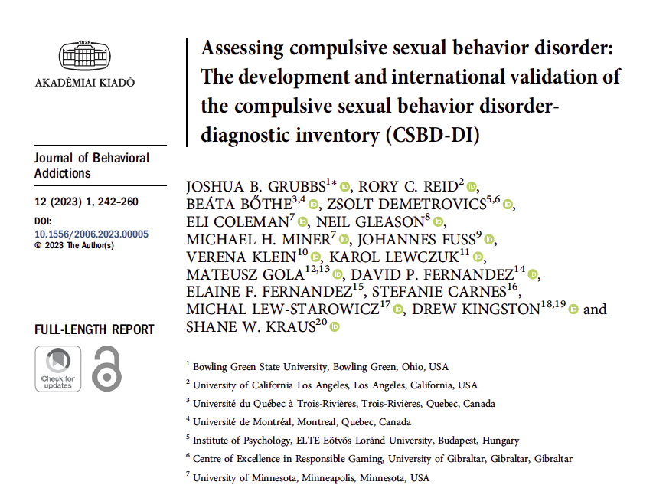
Notes:
Feel free to reach out if you are interested in this article
This study looked at the development of the tool across two studies which involved multiple samples and 6 different countries.

Slide 61
CSBD:DI
I have spent too much time focused on sexual behavior while neglecting other areas
Numerous unsuccessful attempts to stop
Engage in sexual behavior despite risk of physical harm
Engage in sexual behavior despite risk of emotional harm
Sexual behaviors cause significant distress
Sexual behaviors cause problems or consequences
Sexual behaviors give little or no pleasure
Sexual behaviors used to escape or distract from unpleasant feelings
Sexual behaviors used to avoid or cope with stressful experiences
Notes:
The CSBD: DI is 7 items with strong psychometric properties and cross-cultural validity
You probably see 9 items but we don’t score 8 or 9 as these were coping items that are clinically informative but not mean to be diagnostically informative.
You add up the first seven items for those that are “currently endorsed” the left box
It was suggested that a cutoff of 2 be set for further diagnostic evaluation

Slide 62
Assessment Overview
Comprehensive clinical/psychiatric interview
Diagnostic relevant questions
Medical testing
Rule out medical or other conditions/causes
Multi-method/modal assessments
Clinician administered and self-report
Emphasis placed on empirically derived cut-off’s
Notes:
Now if you have someone who should be further assessed, you should proceed with a comprehensive assessment
Includes a
1) comprehensive interview - focused on dx relevant questions. A deeper dive on what was asked in the screening.
2) Want to ensure that we rule out other potential medical or other causes that could explain the behavior (e.g., head injury's and medications)
3) A multi-modal assessment - Big fan of integrating self-report and clinician interview with other sources - considering beahviors, collateral interviews with family etc.

Slide 63
Dimensions of CSBD
CSBD
Sexual Drive
Sexual frequency, preoccupation, impersonal sex
Problematic Sexuality
Impulsivity and emotion dysregulation
Notes:
When I mentioned diagnostically relevant items, you have have the ICD and to some extent the DSM criteria as guides.
I also think you should consider the broad factors thought to underly CSBD.
This was addressed nicely during the student research talks yesterday
This highlights the work of Ray Knight and colleagues and the notion that CSBD is not simply sexula drive as once thought but better reflected by two factors
Sexual Drive
Problemeatic sexuality

Slide 64
Sexual Drive
Can people have too much sex and do we care?
Notes:
Let’s focus on the first core construct to be examined…sexual drive
Can people have too much sex and do we care.
It’s a weird question but I think people can have statistically elevated rates of sexual activity which is helpful to know but of course a more central question is whether that results in problems.
You can have someone who has lots of sex and is really living a great and healthy life
You can also have someone who is having very little sex but complains about their life and finds the fact that they masturbate once per month to be a problem
Let’s first look at measuring sexual drive

Slide 65
Normative Data
Notes:
norms are important
It's a continuum
There were a few early studies in more or less representative samples highlighting normative data.
Kinsey

Slide 66
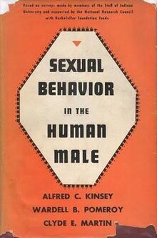
Notes:
Everyone is aware of some early examples of surveys asking people about their sex life and the construction of norms from this information

Slide 67
Identifying High Rates of Sexual Behavior (Långström & Hanson, 2006)
Variable | Men | Women
Masturbation (# past month) | ≥ 15 (M = 4.9) | ≥ 5 (M = 1.6)
Pornography (# past year) | ≥ 31 (M = 14) | ≥ 4 (M = 1.4)
Sexual partners (# past year) | ≥ 3 (M = 1.4) | ≥ 2 (M = 1.2)
Notes:
Most of you may know this 2006 study which examined more than 2K adult men and women drawn from a national survey in Sweden in order to identify risk factors and correlates of elevated rates of sexual behavior.
High levels of sexual behaviors were identified based on selecting the point near the 90th percentile.
read off examples
They also noted that engaging in impersonal sex was associated with more negative correlates than engagement with a partner suggesting type of outlet is important

Slide 68
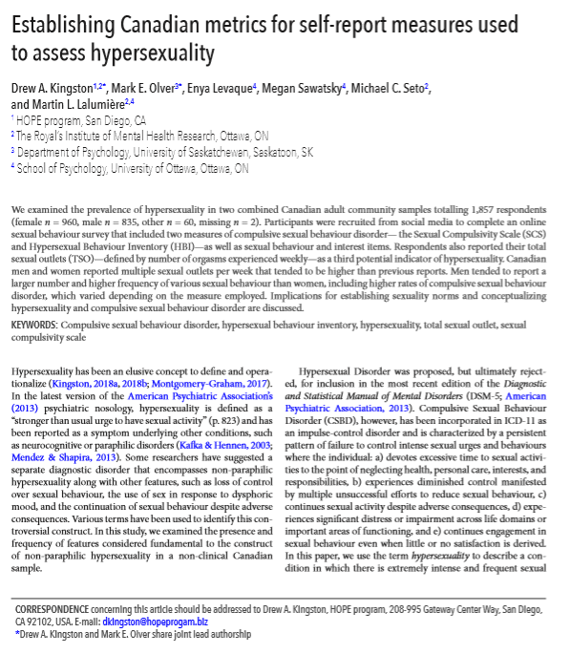
Kingston, D. A., Olver, M. E., Levaque, E., Sawatsky, M., Seto, M., & Lalumière, M. (2020). Establishing Canadian Metrics for Self-report Measures Used to Assess Hypersexuality. Canadian Journal of Human Sexuality
Notes:
adult community sample - about 2K

Slide 69
Canadian Sex Statistics
Sexual history variable | Total sample |  | Male | Female | t/χ2
 | Mean (SD) or % | Range | Mean (SD) or %
Masturbation (previous month) | 14.9 (14.2) | 0-60 | 21.7 (14.8) | 7.2 (8.5) | 17.51***
Masturbation (typical week) | 4.0 (4.0) | 0-30 | 5.7 (4.3) | 2.0 (2.4) | 15.75***
Sexual contact monthly (previous year) | 11.7 (14.7) | 0-60 | 10.8 (13.6) | 12.7 (15.7) | -1.85
Sexual contact (previous month) | 6.1 (7.9) | 0-60 | 6.2 (7.9) | 6.0 (7.9) | 0.28
Sexual partners (lifetime) | 13.3 (32.1) | 1-500 | 15.5 (39.3) | 11.2 (23.6) | 1.82
Sexual intercourse (previous month) | 5.9 (7.7) | 0-60 | 5.9 (7.7) | 6.1 (7.7) | -0.38
Sexual intercourse (previous week) | 1.4 (1.9) | 0-12 | 1.5 (2.0) | 1.3 (1.9) | 0.83
Total sexual outlet (TSO; week) | 6.2 (5.9) | 0-50 | 7.2 (6.5) | 5.4 (5.4) | 6.45
Extramarital affair (ever) | 27.6 | - | 31.7 | 23.1 | 5.75*
Phone sex (previous year) | 7.2 | - | 6.0 | 8.5 | 1.92
Cybersex (previous year) | 17.1 | - | 21.4 | 12.6 | 11.31***
Strip clubs (previous year) | 21.9 | - | 25.1 | 18.3 | 5.38*
Pay for sex (ever) | 6.9 | - | 12.8 | 0.5 | 48.48***
Diagnosed with STI (ever) | 10.6 | - | 8.7 | 13.2 | 5.05*
Notes:
These are the means and frequencies for the sample as a whole not taking into account gender.
Canadians report an active sex life, both solo and person involved. (winters vs maple syrup) There are a few themes worth pointing out.
The average monthly masturbation count was 15 –top 10% of other samples.
The same conclusion can be drawn about TSO 7 might be a relic of the 1940s during the Kinsey era.
Other possible indicators of hypersexuality had a much lower base rate.

Slide 70
Canadian Sex Statistics
Sexual history variable | Total sample |  | Male | Female | t/χ2
 | Mean (SD) or % | Range | Mean (SD) or %
Masturbation (previous month) | 14.9 (14.2) | 0-60 | 21.7 (14.8) | 7.2 (8.5) | 17.51***
Masturbation (typical week) | 4.0 (4.0) | 0-30 | 5.7 (4.3) | 2.0 (2.4) | 15.75***
Sexual contact monthly (previous year) | 11.7 (14.7) | 0-60 | 10.8 (13.6) | 12.7 (15.7) | -1.85
Sexual contact (previous month) | 6.1 (7.9) | 0-60 | 6.2 (7.9) | 6.0 (7.9) | 0.28
Sexual partners (lifetime) | 13.3 (32.1) | 1-500 | 15.5 (39.3) | 11.2 (23.6) | 1.82
Sexual intercourse (previous month) | 5.9 (7.7) | 0-60 | 5.9 (7.7) | 6.1 (7.7) | -0.38
Sexual intercourse (previous week) | 1.4 (1.9) | 0-12 | 1.5 (2.0) | 1.3 (1.9) | 0.83
Total sexual outlet (TSO; week) | 6.2 (5.9) | 0-50 | 7.2 (6.5) | 5.4 (5.4) | 6.45***
Extramarital affair (ever) | 27.6 | - | 31.7 | 23.1 | 5.75*
Phone sex (previous year) | 7.2 | - | 6.0 | 8.5 | 1.92
Cybersex (previous year) | 17.1 | - | 21.4 | 12.6 | 11.31***
Strip clubs (previous year) | 21.9 | - | 25.1 | 18.3 | 5.38*
Pay for sex (ever) | 6.9 | - | 12.8 | 0.5 | 48.48***
Diagnosed with STI (ever) | 10.6 | - | 8.7 | 13.2 | 5.05*
Notes:
males were about triple females on masturbation frequency
difference was much smaller on TSO (about 1/3 SD).
women’s average frequencies might be construed as borderline hypersexual using Kinsey criteria or findings from Langstrom and Hanson.
But what this illustrates is the need for new norms (or “metrics” if you will) to highlight what is sexually typical or atypical for Canadians.

Slide 71
SCS Percentile Ranks
Men |  |  |  | Women
Score | Below | Freq | Percentile | Score | Below | Freq | Percentile
10 | 0 | 5.7 | 2.8 | 10 | 0 | 16.4 | 8.2
11 | 5.7 | 10.0 | 10.7 | 11 | 16.4 | 18.2 | 25.5
12 | 15.7 | 8.7 | 20.0 | 12 | 34.6 | 11.2 | 40.2
13 | 24.4 | 8.9 | 28.8 | 13 | 45.8 | 9.4 | 50.5
14 | 33.3 | 8.7 | 37.6 | 14 | 55.2 | 9.1 | 59.7
15 | 42.0 | 6.5 | 45.2 | 15 | 64.3 | 6.0 | 67.3
16 | 48.5 | 8.2 | 52.6 | 16 | 70.2 | 5.6 | 73.0
17 | 56.7 | 6.7 | 60.0 | 17 | 75.8 | 4.3 | 77.9
18 | 63.4 | 4.3 | 65.5 | 18 | 80.1 | 3.6 | 81.9
19 | 67.7 | 4.2 | 69.8 | 19 | 83.7 | 1.7 | 84.5
20 | 71.8 | 4.2 | 73.9 | 20 | 85.4 | 2.4 | 86.6
21 | 76.0 | 3.3 | 77.6 | 21 | 87.8 | 1.7 | 88.6
22 | 79.3 | 1.8 | 80.2 | 22 | 89.6 | 1.1 | 90.1
23 | 81.1 | 2.5 | 82.3 | 23 | 90.6 | 1.6 | 91.4
24 | 83.6 | 1.9 | 84.5 | 24 | 92.2 | 1.5 | 92.9
25-29 | 85.6 | 1.8 | 86.5-91.9 | 25-29 | 93.7 | 1.0 | 94.2-97.3
30-34 | 92.4 | 1.2 | 93.0-96.2 | 30-34 | 97.7 | 0.4 | 97.9-99.4
35-40 | 96.7 | 1.0 | 97.2-99.6 | 35-40 | 99.5 | 0.1 | 99.5-99.9
Mean | 17.45 |  |  | Mean | 14.60
SD | 6.63 |  |  | SD | 5.12
Notes:
Here are the percentile ranks for the Sexual Compulsivity Scale, a 10-item self-report with items scored on a 1-4-point scale.
Kalichman used 24 as a cutoff for hypersexuality
In our data 24 = 1SD above the mean and seem to be a reasonable cut score for statistical infrequency.
For women on the other hand, 19 gets at about 1SD above the mean. A score of 24 for women would be getting close to 2SDs above the mean.
The Canadian male average is around 17 while for women it is around 14-15

Slide 72
HBI Percentile Ranks
Male |  |  |  | Female
Score | Below | Freq | Percentile | Score | Below | Freq | Percentile
19-24 | 0 | 11.2 | 1.2 - 10.1 | 19-24 | 0 | 18.7 | 1.8 - 17.1
25-29 | 11.1 | 12.9 | 12.4 - 22.4 | 25-29 | 18.7 | 20.0 | 20.0 - 36.4
30-34 | 23.9 | 16.3 | 25.4 - 38.2 | 30-34 | 38.7 | 17.1 | 41.1 - 54.3
35-39 | 40.2 | 15.3 | 41.9 - 53.9 | 35-39 | 55.8 | 13.0 | 57.2 - 67.9
40-44 | 55.4 | 12.5 | 56.3 - 66.8 | 40-44 | 68.9 | 9.9 | 69.9 - 77.8
45-49 | 67.9 | 9.7 | 69.2 - 76.8 | 45-49 | 78.7 | 7.2 | 79.4 - 85.3
50-54 | 77.5 | 5.9 | 77.8 - 82.7 | 50-54 | 86.0 | 5.4 | 87.0 - 91.0
55-59 | 83.4 | 5.0 | 83.9 - 88.2 | 55-59 | 91.4 | 3.5 | 91.7 - 94.4
60-64 | 88.3 | 2.7 | 88.6 - 90.9 | 60-64 | 94.9 | 2.0 | 95.2 - 96.8
65-69 | 91.0 | 2.2 | 91.3 - 93.1 | 65-69 | 96.9 | 1.1 | 96.9 - 97.8
70-74 | 93.2 | 1.8 | 93.5 - 94.9 | 70-74 | 98.1 | 0.5 | 98.1 - 98.4
75-79 | 95.0 | 2.2 | 95.3 - 97.1 | 75-79 | 98.5 | 0.8 | 98.5 - 99.2
80-84 | 97.2 | 0.6 | 97.3 - 98.0 | 80-84 | 99.3 | 0.1 | 99.3 - 99.4
85-89 | 98.3 | 0.8 | 98.3 - 99.0 | 85-89 | 99.4 | 0.2 | 99.4 - 99.5
90-95 | 99.1 | 0.9 | 99.1 - 99.9 | 90-95 | 99.7 | 0.3 | 99.7 - 99.9
Mean | 40.81 |  |  | Mean | 35.59
SD | 15.43 |  |  | SD | 12.83
Notes:
For the HBI, Reid suggested 53
Male SD = score of 55
Women SD = score of 49

Slide 73
TSO Percentile Rank
Male |  |  |  | Female
Score | Below | Freq | Percentile | Score | Below | Freq | Percentile
0 | 0 | 0.7 | 0.3 | 0 | 0 | 5.3 | 2.6
1 | 0.7 | 2.2 | 1.8 | 1 | 5.3 | 10.9 | 10.8
2 | 2.9 | 2.7 | 4.2 | 2 | 16.2 | 7.3 | 19.8
3 | 5.6 | 6.6 | 8.9 | 3 | 23.5 | 9.0 | 28.0
4 | 12.2 | 10.4 | 17.4 | 4 | 32.5 | 10.4 | 37.7
5 | 22.6 | 12.7 | 28.9 | 5 | 42.8 | 9.7 | 47.6
6 | 35.3 | 18.6 | 44.6 | 6 | 52.5 | 17.3 | 61.1
7 | 53.8 | 17.3 | 62.4 | 7 | 69.9 | 14.8 | 77.3
8 | 71.2 | 16.4 | 79.4 | 8 | 84.7 | 11.1 | 90.2
9 | 87.5 | 1.7 | 88.3 | 9 | 95.8 | 0.2 | 95.9
10 | 89.3 | 4.2 | 91.4 | 10 | 96.0 | 1.1 | 96.5
11 | 93.4 | 0.2 | 93.5 | 11 | 97.0 | 01 | 97.1
12 | 93.7 | 0.6 | 94.0 | 12 | 97.1 | 0.1 | 97.2
13 | 94.3 | 0.2 | 94.4 | 13 | 97.3 | 0.1 | 97.4
14 | 94.5 | 1.5 | 95.2 | 14 | 97.4 | 0.2 | 97.5
15 | 96.0 | 0.2 | 96.1 | 15 | 97.6 | 0.2 | 97.7
16-25 | 96.2-97.8 | 1.6 | 96.2-97.9 | 16-25 | 97.8-98.3 | 0.5 | 97.9-99.4
26-50 | 97.9-98.7 | 2.2 | 97.9-99.3 | 26-50 | 98.3-99.3 | 1.6 | 99.5-99.9
Mean (SD) | 7.21 (6.45) |  |  | Mean (SD) | 5.4(5.41)
n | 819 |  |  | n | 946
Notes:
First highlight = 50th percentile
next is for a TSO of 7
last is those who score 1 SD above the mean.
the average Canadian male would be considered hypersexual by strict TSO standards
TSO of 9 or 10 starts to get pretty rare for Canadian men,
Canadian women = 8.

Slide 74
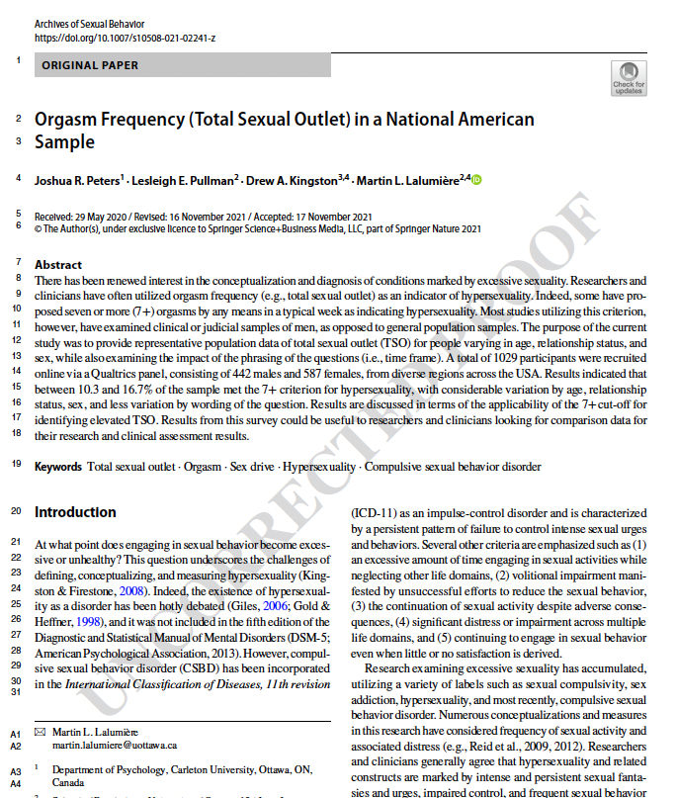
Peters, J. R., Pullman, L. E., Kingston, D. A., & Lalumière, M. (2022). Orgasm Frequency (Total Sexual Outlet) in a National American Sample. Archives of Sexual Behavior, 51, 1447-1460.
N = 1029
Notes:
Some colleagues and I also looked at TSO specifically
In this case, we looked at a representative sample in North America. Included about 1K men and women recruited online

Slide 75
Orgasm Frequency
Average TSO = 3 per week
Notes:
Describe the graph
The average across both genders was 3
but
Males consistently reported higher orgasm frequencies than females which is a pretty robust finding across studies
Also, an age effect 55+ lower orgasms
This is also pretty robust although we didn't find this in our Canadian study I showed you earlier
25% of the sample would have met 7+ orgasms per week. Again, suggesting that the traditional cut-off used simply does not apply anymore

Slide 76
TSO Meta-Analysis
29 Studies (36 samples) published from 1964 to 2019
14,297 Female participants
9,111 Male participants
98% White
0.8% Black
0.8% West Asian
0.5% Other groups
Levaque, Sawatsky, Kingston, Pullman, Walters, Fox, Légère , Lalumiere, 2024
Notes:
Most recently, we have just completed a meta-analysis that looked at about 25K participants, most of whom were white

Slide 77
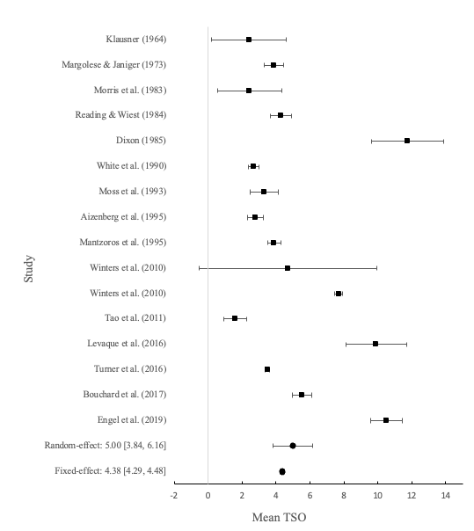
Notes:
here you can see the forest plots for female TSO on the left and male TSO on the right

Slide 78
Female TSO = 2.52 (2% met 7+TSO)
Male TSO = 4.38 (24% met 7+ TSO)
Moderators
Recent Studies > Older
Younger age > Older age
Gay/bisexual > straight
Single > committed relationships
Notes:
Overall, you can see a pretty clear gender difference in TSO
Females – 2.5
Males -- just over 4 per week
You can also see that a TSO of 7 is inappropriate to use as a cutoff
Better to consider 8-9 for men and 5-6 for women as an initial benchmark of hypersexuality
We also found some interesting moderators as shown here
Of course, this is just specifically sexual drive or hypersexuality. There are other domains that need to be assessed when you consider the broader construct of CSBD. This is where some additional measures can be helpful

Slide 79
Measurement of CSBD

Slide 80
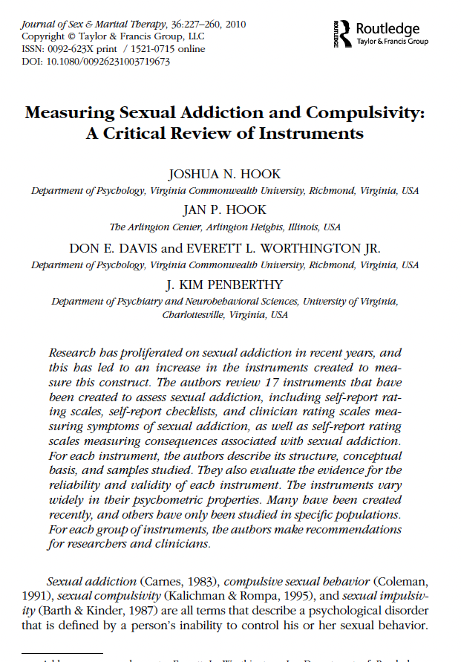
Hook, J. N., et. al. (2010). Measuring Sexual Addiction and Compulsivity: A Critical Review of Instruments. Journal of Sex and Marital Therapy, 36, 227-260.
Notes:
This is a useful article to have on hand
Authors reviewed 17 Instruments created to assess CSBD.
They divided the instruments into 4 types
Self-report rating scales – assess one’s experience of CSBD
Self-report Checklists – similar to # 1 but usually yes/no and can be done quick
Clinician rating scales – administered by a professional
Self-report of consequences – focus on consequences
Went on to describe significant findings, samples utilized, reliability, validity.
Based on these metrics, they made some recommendations in each category.
They specifically recommended rating scales over checklists and the benefit of using scales tied to diagnostic criteria
So, let's talk about our options here

Slide 81
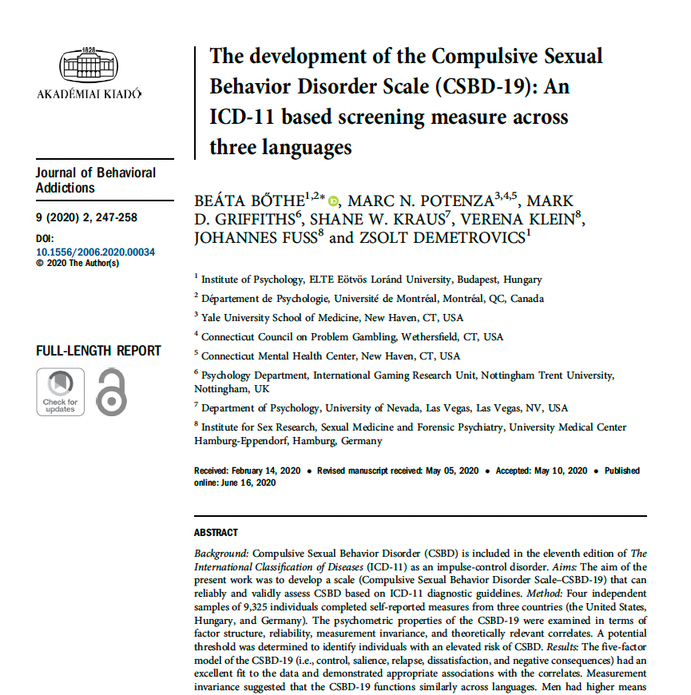
Notes:
Obviously there is not a great deal on dx scales.
I mentioned our screening scale earlier which is tied to diagnosis
Here we have the Compulsive Sexual Behavior Disorder Scale
It has 19 items that are mapped onto ICD diagnostic criteria.
Each question (e.g., I had sex even when I did not enjoy it anymore) is scored on a 1 (totally disagree) to 4 (totally agree) scale
Score of 50 points was considered a useful threshold to identify those at high risk of CSBD. Showed some good psychometric properites

Slide 82
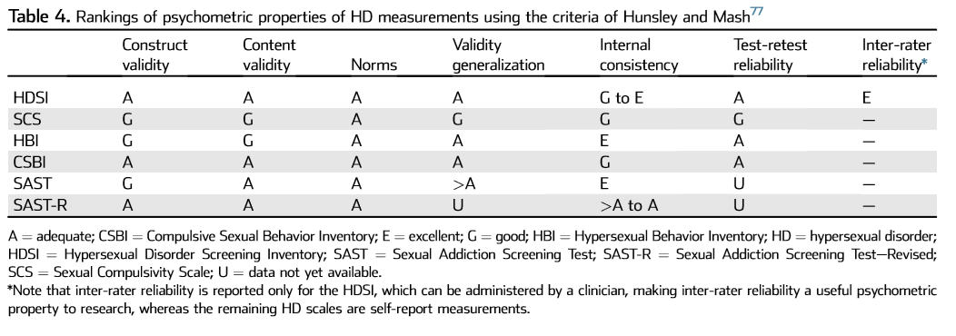
Psychometric Properties of HD Assessment Tools
Montgomery-Graham (2017, p. 158)
Notes:
This was from a dissertation from University of Western
She employed Hunsley and Mash’s criteria to award a highly recommended rating based on the results of reliability and validity re: good, adequate excellent
None of the measures were highly recommended but:
The HDSI was recommended which was the dx scale asssociated with DSM-5 criteria
Also, the SCS and HBI were recommended

Slide 83
Recommended Assessment Approach
Screening Questions/tools
CSBD-DI or related questions during standard interview
Comprehensive Semi-Structured Interview
Sexual drive and sexual frequency (TSO)
Other diagnostically relevant indicators
Self-report tools
Compulsive Sexual Behavior Disorder Scale (CSBD-19)
Hypersexual Behavior Inventory
Notes:
I recognize that I didn’t discuss the MIDSA but it’s on my recommendations. I do this because it’s a phenomenal option to consider and I know most people here would be aware of it.
It is long in its entirety but provides a lot of very useful information both clinically and in the research we have done with CSBD.

Slide 84
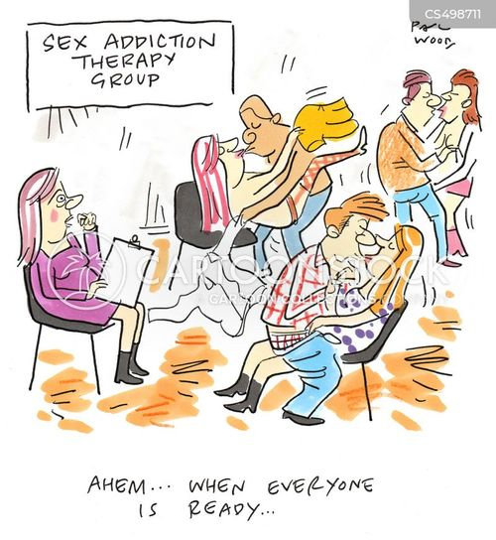
Treatment

Slide 85
Types of Interventions
Support Groups
Medication
Psychotherapeutic
Residential Treatment
Outpatient Treatment
Notes:
There are different types of interventions throughout the literature
Broadly, these can be grouped into the popular support type groups, meds, and psychological approaches

Slide 86
Support Groups: 12 Steps
Religious/Spiritual foundation
Experienced member as guide (sponsor)
CSBD is a chronic disease in which the individual has no control
Believe in a higher power, admit to wrongdoing, ask for forgiveness
Notes:
several iterations, sexholics anonymous and love addicts anonymous
They are heavily influenced by the substance abuse model and 12-steps specifically

Slide 87
12 Steps
We admitted we were powerless over addictive sexual behavior - that our lives had become unmanageable.
Came to believe that a Power greater than ourselves could restore us to sanity.
Made a decision to turn our will and our lives over to the care of God as we understood God.
Made a searching and fearless moral inventory of ourselves.
Admitted to God, to ourselves, and to another human being the exact nature of our wrongs.
Were entirely ready to have God remove all these defects of character.
Humbly asked God to remove our shortcomings.
Made a list of all persons we had harmed and became willing to make amends to them all.
Made direct amends to such people wherever possible, except when to do so would injure them or others.
Continued to take personal inventory and when we were wrong promptly admitted it.
Sought through prayer and meditation to improve our conscious contact with God as we understood God, praying only for knowledge of God's will for us and the power to carry that out.
Having had a spiritual awakening as the result of these steps, we tried to carry this message to other sex addicts and to practice these principles in our lives.
Notes:
Read a few
I have personally struggled with the notion of giving up power and control when autonomy and personal choice is what I focus so much on in treatment but I recognize that I am a bit out of my lane on the 12 step models.
What do you think?

Slide 88
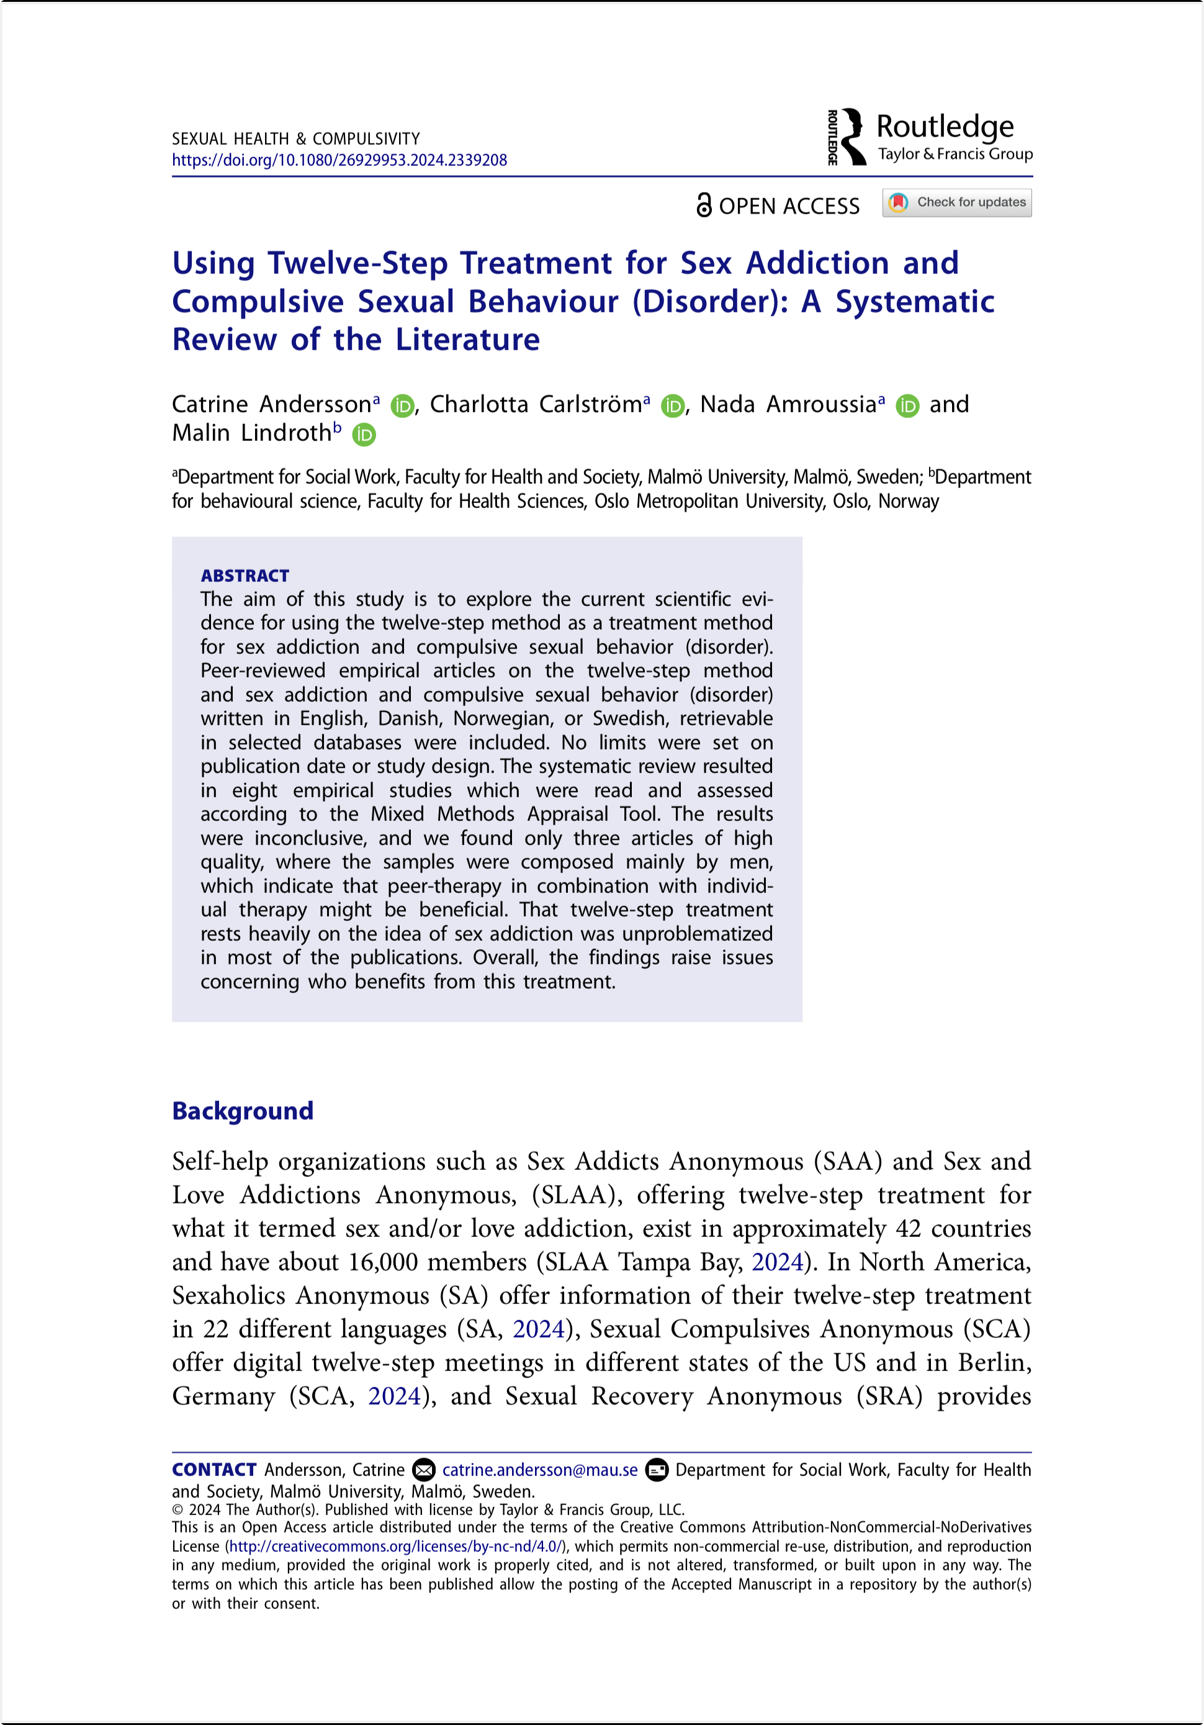
Notes:
Not much research but what has been done suggests that it can be a nice addition to other types of interventions.
It is suportive by nature

Slide 89
Some benefit but methodologically weak studies
e.g., Small and non-diverse samples
Notes:
Not much research but what has been done suggests that it can be a nice addition to other types of interventions.
It is suportive by nature

Slide 90
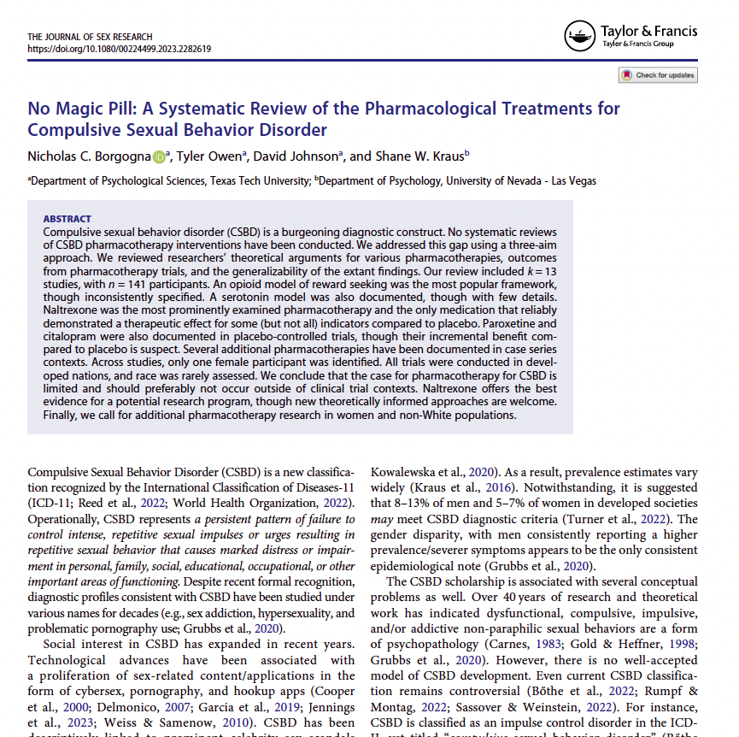
Borgogna, N., Owen, T., Johnson, D., & Kraus, S. W. (2023). No Majic Pill. A Systematic Review of the Pharmacological Treatments for Compulsive Sexual Behavior Disorder. Journal of Sexual Research
K = 13, N = 141
Notes:
Moving toward medication approaches
Here is a new and helpful article on medication management of CSBD

Slide 91
Pharmacotherapy has limited research support
Some potential benefit (albeit mixed) for Naltrexone
Cautioned use outside of controlled clinical trials
Notes:
Take home was that there is limited research support and much to be desired regarding future research
They highlighted some support for Naltrexone but overall cautioned use of medications outside controlled clinical trials
There was another study by Turner and colleagues which I don’t show here but they do make some specific recommendations about medications that are contingent on the level of severity of CSBD and they provide an algorithm to inform decisions about which option is best

Slide 92
Residential Treatment Programs
Notes:
With regard to residential programs, it’s a hodgepodge of interventions
Some seem reasonable to me (CBT) but others less so (equine therapy)
Reminds me of the early research on correctional based programs. Large scale examinatiosn questioned the utility of whether treatment works but a closer look showed that some programs worked well whereas others really didn’t.
Therefore, it’s not whether it works but what works
Probabaly something similar is going on here.

Slide 93
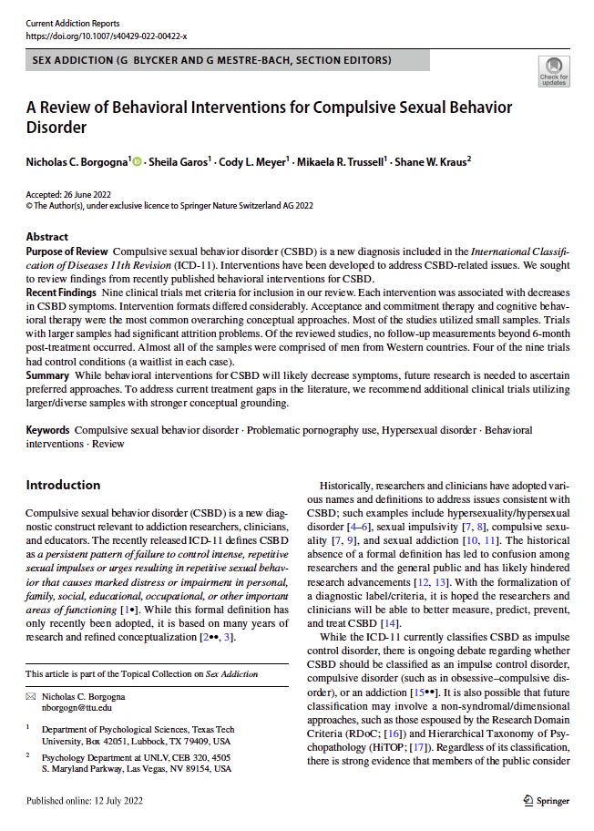
Borgogna, N. C., Garos, S., Meyer, C. L., Trussell, M. R., & Kraus, S. W. (2022). A Review of Behavioral Interventions for Compulsive Sexual Behavior Disorder. Current Addiction Reports.
Notes:
nine clinical trials, including some RCTs
interventions were ACT or CBT
resulted in improved hypersexual symptoms among participants
methodological issues were noted, such as small, selected samples and lack of follow-up
Treatment attrition was another notable problem identified across the studies with some samples reporting more than 75% of participants dropping out.
Attrition and motivation to stay in the program is one of the key take away’s here

Slide 94
Empirically-Informed Approaches

Slide 95
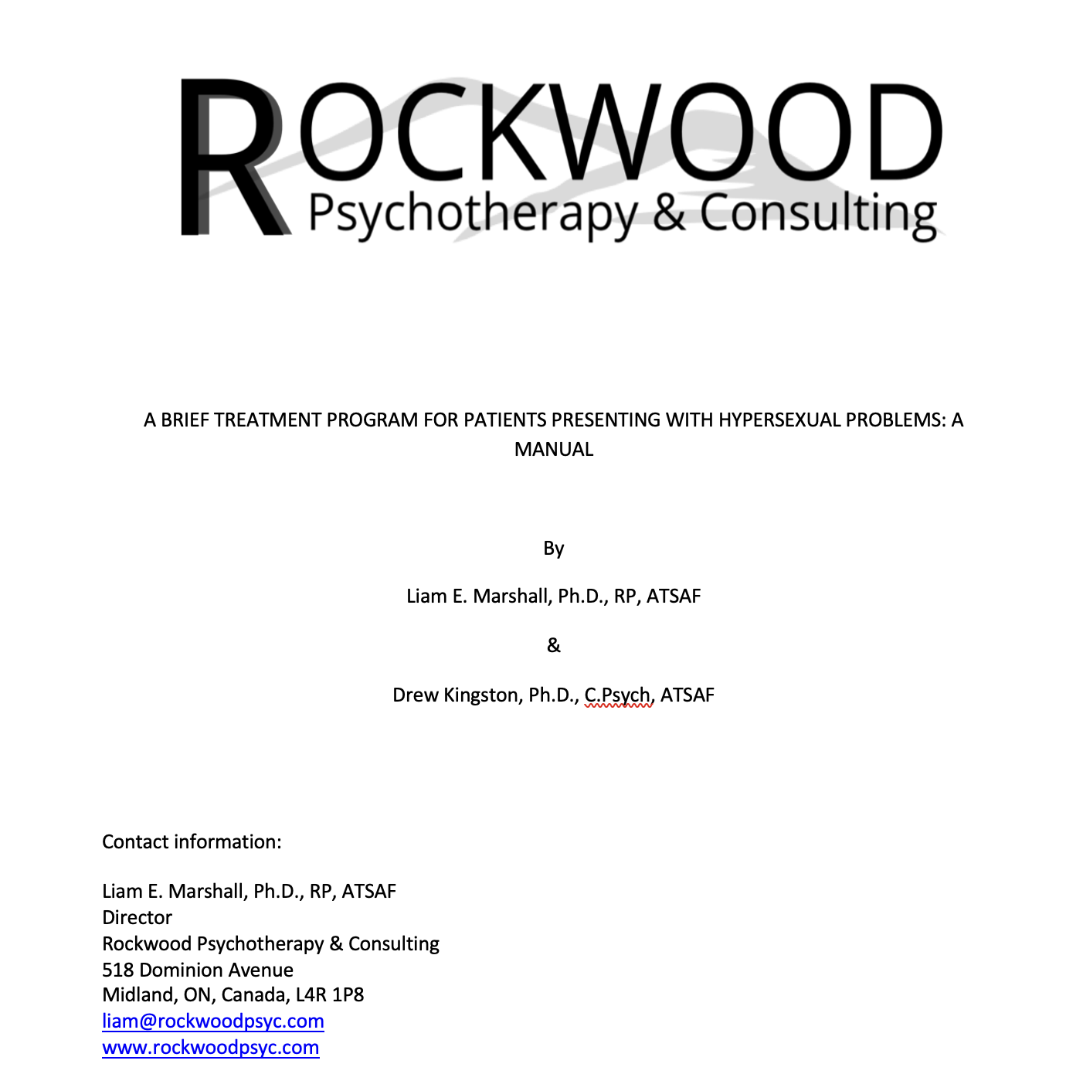

Slide 96
Phased Approach
Phase 1: Enhancing Motivation | Phase 2: Core Issues | Phase 3: Building a Better Future
Engagement/Motivation | Improve Functioning | Integration and Maintenance
Problem Identification | Relationship Issues | Risk Factors
Safety Plan | Healthy Sexuality | Goal Setting
Background Information | Emotional Regulation | Self-management
Autobiography | Coping | Future Plans
Notes:
Structure treatment across three phases
1 --
2 --
3 --
want to provide a snapshot of 1-2 interventions in each phase

Slide 97
Phased Approach
Phase 1: Enhancing Motivation | Phase 2: Core Issues | Phase 3: Building a Better Future
Engagement/Motivation | Improve Functioning | Integration and Maintenance
Problem Identification | Relationship Issues | Risk Factors
Safety Plan | Healthy Sexuality | Goal Setting
Background Information | Emotional Regulation | Self-management
Autobiography | Coping | Future Plans
Notes:
Structure treatment across three phases
1 --
2 --
3 --
want to provide a snapshot of 1-2 interventions in each phase

Slide 98
Phased Approach
Phase 1: Enhancing Motivation | Phase 2: Core Issues | Phase 3: Building a Better Future
Engagement/Motivation | Improve Functioning | Integration and Maintenance
Problem Identification | Relationship Issues | Risk Factors
Safety Plan | Healthy Sexuality | Goal Setting
Background Information | Emotional Regulation | Self-management
Autobiography | Coping | Future Plans
Notes:
Structure treatment across three phases
1 --
2 --
3 --
want to provide a snapshot of 1-2 interventions in each phase

Slide 99
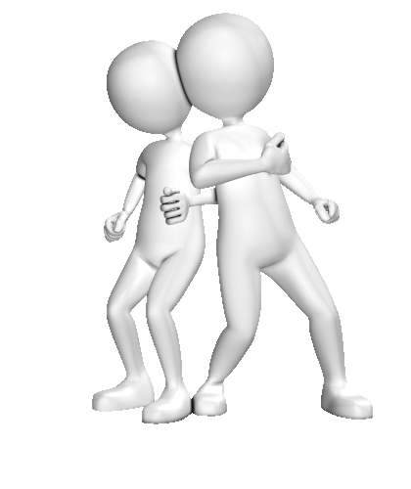
Phase 1: Enhancing Motivation
Notes:
Enhancing motivation is important, particularly when we are working with clients who have become reliant upon a pleasurable activity that has produced some short-term benefits.
Also recall the data I shared earlier re: high attrition rates.
Clearly, motivation is important

Slide 100
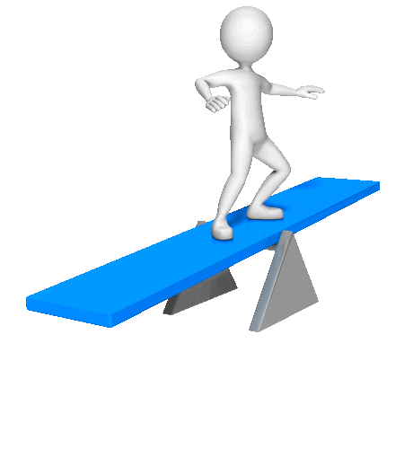
Approaches Toward Treatment
Confrontational
Acquiescent
100
Notes:
To start broadly, I think the approach we take in treatment probably has more of an effect than any specific intervention.
Acquiescent = very self-confident and happy people who continues to engage in the problematic behavior
Confrontational – leads to shame and anger or you might get someone who superficially accepts what you say just so they can get out of your office but no real change is taking place

Slide 101
Relationship Factors
Effective Therapist Characteristics
Empathic Genuine Warm Respectful Supportive | Directive Flexible Encouraging Participation Rewarding | Attentive Confident Collaborative Strength-focused Trustworthy
Notes:
Keeping with the theme of the approach you choose in treatmet, it makes sense to consider the characteristics that are actually associated with change…at least as shown in people who have committed sexual offenses
The goal is to create a dynamic that reflects mutual respect, caring, and rapport
In addition to facilitating motivation it also creates a dynamic where the client is going to be likely more responsive when you have to provide expressions of disapproval.
If you have set a confrontational dynamic, the opportunity for change following expressions of disapproval are lost.

Slide 102
MI: Key Principles
Open-ended questions, Affirmations, Reflective listening, and Summarizing
Sustain Talk vs Change Talk
Expressing Empathy
Develop discrepancy
Amplify the discrepancy between current situation and goals
Roll with resistance
Avoid arguing for behavior change
Accept ambivalence and elicit alternative perspectives
Support self-efficacy
Notes:
I am sure everyone is familiar with these but they are so important which is why I include them. Be mindful of the OARS strategies or tools
Try to “catch” and respond to sustain talk vs change talk
Sustain Talk
I have little desire to change and not sure why I would anyway
Open-ended q – If it was important, why might that be the case?
Change Talk
I have to do something about my constant cheating
Reflection – Sounds like this is a turning point for you
Read off 1-4

Slide 103
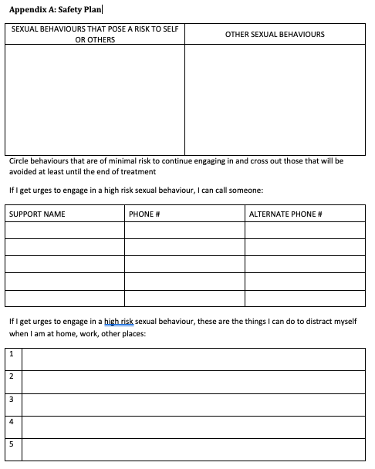
Notes:
Here is an example of a safety plan that we provide and is particular useful in phase 1 of the program
one of the main features is that I don't want them to cease all sexual activity. There is a notion of celibacy contracts in programs which I don't think is a good thing.
I want to differentiate healthy from harmful sexual activity and not reinforce sex as shameful

Slide 104
Autobiography
Client provides a description of their life
No right or wrong way to write this but ideally focus on:
Childhood
Relationships
Major life events
Work history
What they leave out is potentially more important than what they include
Notes:
Another very helpful assignment is the autobiography
Purpose is to identify strengths and areas of need such as maladaptive schema, attachment concerns, early messages received about sexuality.
Clients would complete this on their own and then present in group
We process the positives about this assignment and then open it up for questions and feedback.
What the client didn’t put in is likely more important and relevant questions should address this to inform the conceptualization and identification of treatment need
Sometimes they will re-do this assignment and re-present based on new insights and feedback

Slide 105
Phase 2: Core Issues
Notes:
After this phase, individuals transition to the core issues phase

Slide 106
Mood Monitoring
Notes:
Helps with introspection and ability to monitor emotional states
It also starts to reveal patters in mood and external circumstances related to their mood fluctuations.

Slide 107
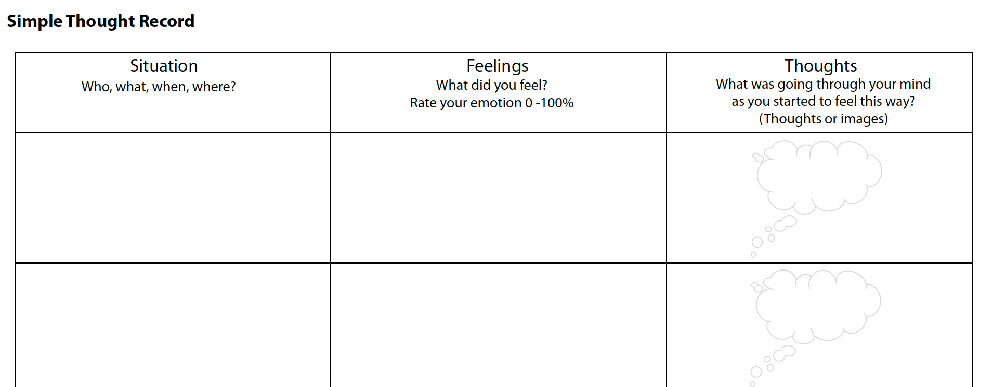
Notes:
sad - 95%
home alone, Saturday night
no one has called me
I am unwanted. No one likes me
Schema - unloveable

Slide 108
Chain Analysis (Linehan, 2002)
Define the problem behavior
Identify the prompting event
What makes me vulnerable
Identify links (Actions, cognitions, events, feelings)
Discuss solutions/prevention strategies
Notes:
After I have a sense of the thoughts and emotions and also the information from the autobiography, it does make sense to create a chain analysis with the client
Kind of like an offense process model with people who have committed sexual offenses

Slide 109
Phase 3: Building a Better Future
Notes:
Finally move into phase 3 – which is focused on sustaining the gains and preparing for life after treatment

Slide 110
Self-Management Plan
Self-management plan #1
Write out personal development goals that would make your life better and less likely to act out again
Self-management plan #2
What warning signs would suggest your goals are not being met
Self-management plan #3
Write out a plan for how you are going to manage your life differently and more positively.
Identify strategies and task-focused coping
Include list of support systems
Notes:
By this point, clients are typically pretty insightful and can develop a pretty good self-management plan
If they have to re-do it after feedback, that is great too.
Summarize 1-3
1 – personal development goals leading to a better life
2 – warning signs that suggest an issue
3 – a more comprehensive self-management plan with specific strategies and support systems identified

Slide 111
Does it work?

Slide 112
Outcome
Attrition
1
Refusers – 3 %
Drop-outs – 4 %
Completion – 96 %
Recidivism
2
Untreated – 20 %
TAU – 10 %
Rockwood – 4%
Rockwood (CSBD) – 6 %
Notes:
By this point, clients are typically pretty insightful and can develop a pretty good self-management plan
If they have to re-do it after feedback, that is great too.
Summarize 1-3
1 – personal development goals leading to a better life
2 – warning signs that suggest an issue
3 – a more comprehensive self-management plan with specific strategies and support systems identified

Slide 113
Conclusions
CSBD remains controversial but has been adopted into the ICD-11
Moving toward understanding how best to define CSBD
Multi-modal assessments are useful while using diagnostic relevant scales
CBT-oriented treatments have shown promise
Strength-based approach
More studies needed with longer-term/focused follow up

Slide 114
Thank you!
dkingston@hopeprogram.biz
https://www.hopeprogram.biz/

